Slide 1


Idea/Approach Details
Objective:
To develop AR-view based bike e-Catalogue mobile application for android and iOS mobile platforms to get insights of bike features.
To improvise the user experience by virtually visiting the showroom.
Solution:
The customer will get the following information about the bike by scanning the QR code.
Specifications (Dimensions, Engine, Chassis), AR-view of bike (for different models), accessories, insights of bike, Warranty period, Dealer info, nearest showroom info, Pricing, user ratings.
Overcomes the disadvantage of the paper catalogue as the customer gets a better view of the bike by the augmented reality.

Slide 2

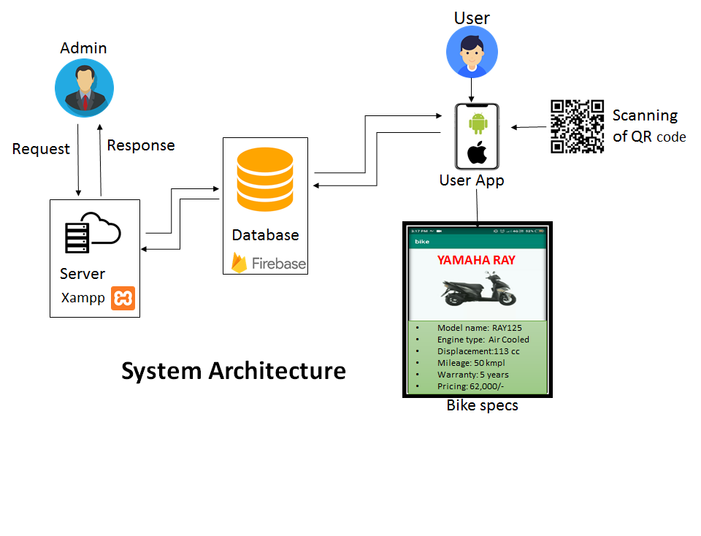







Need:
To get the information of the bike instantaneously.
Proposed System:
Build a new application for virtually visiting the showroom using QR code technology.
Technology Stack:
Platform: Android, iOS, Windows
Software: Flutter(SDK)
Augmented Reality: Unity
Firebase cloud database
PHP QR code library
HTML, CSS, PHP, Dart language
XAMPP Server

Slide 3
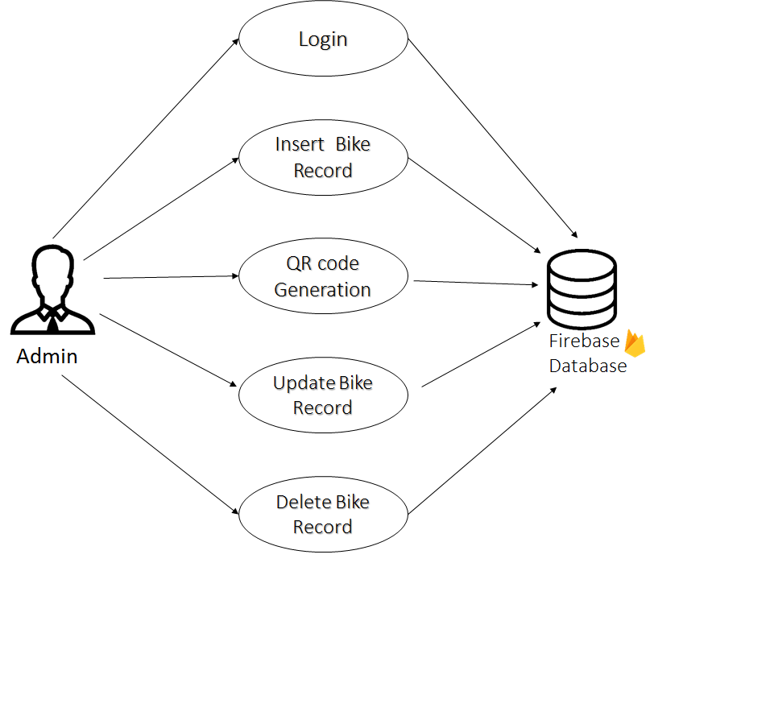
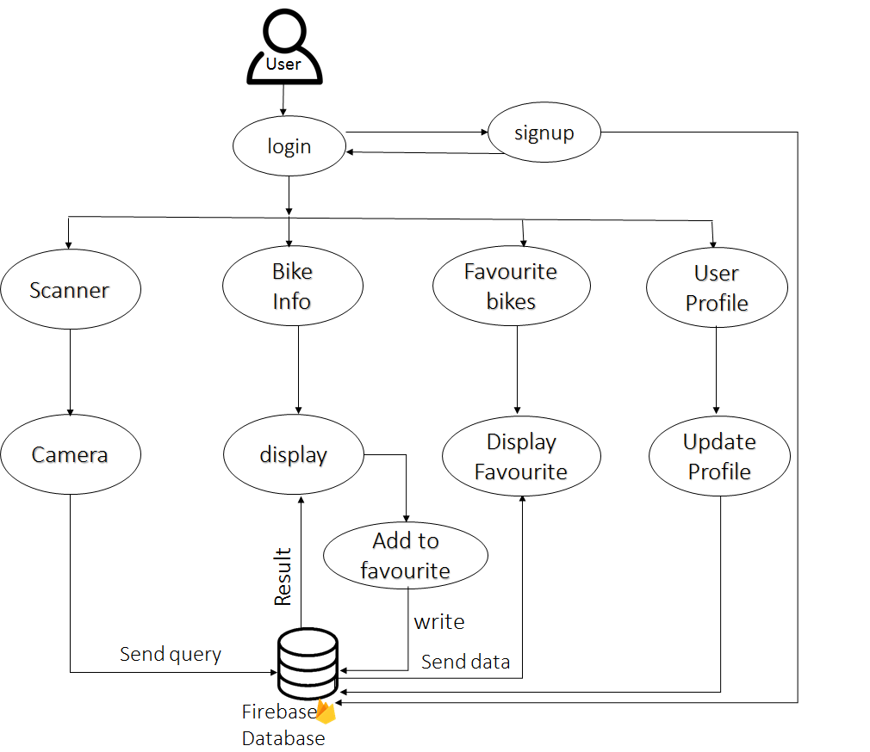
Use Case:
Admin
App User

Slide 4
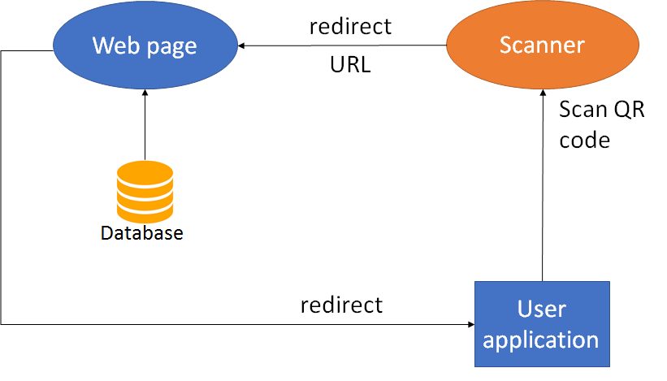
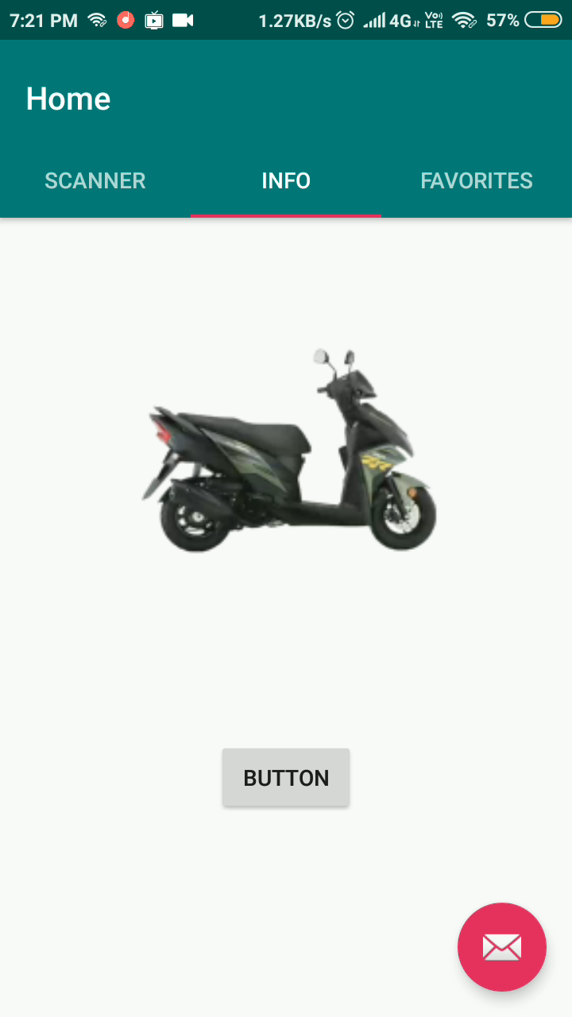
Flow Mechanism:
View of the application
Mobile
Application
Usability :
To improve the user experience giving information about the bike.
Print QR code on bike. User will scan QR code on bike or on the advertisements to visualize bike specifications reducing visit to showroom.

Slide 5

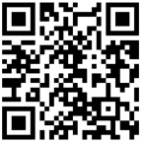
Future Scope:
Online booking of bike and EMI options for purchasing.
The customer can also request for the test drive of the bike.
Dependencies:
Bike specifications from automobile company
References:
www.github.com
www.youtube.com
www.stackoverflow.com
www.quora.com

Slide 6
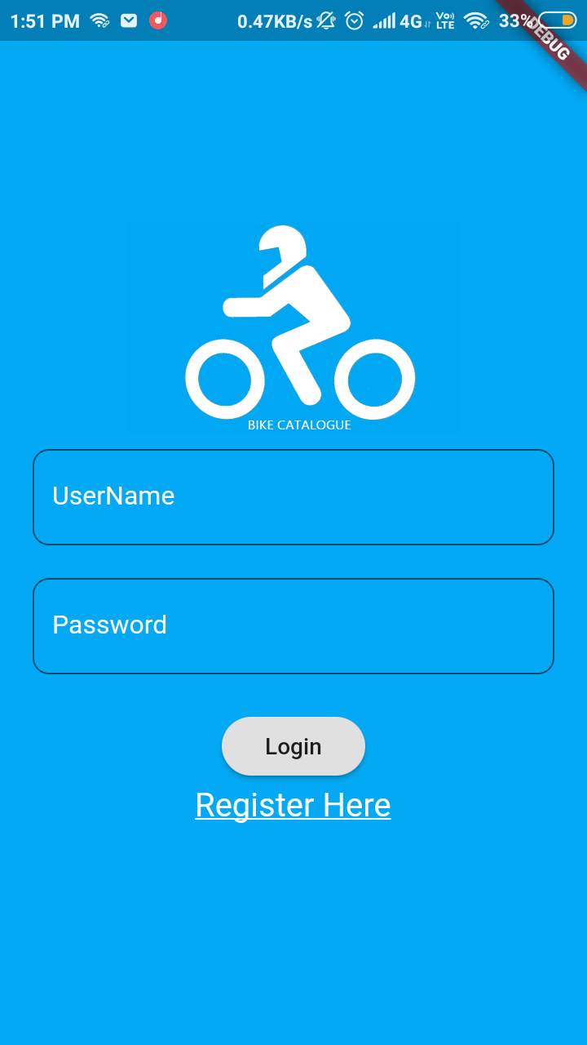
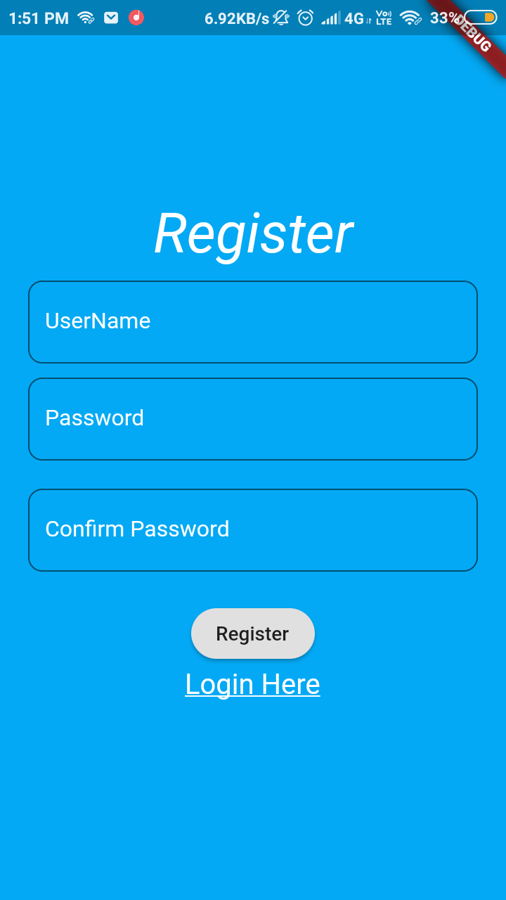
Login & Register

Slide 7
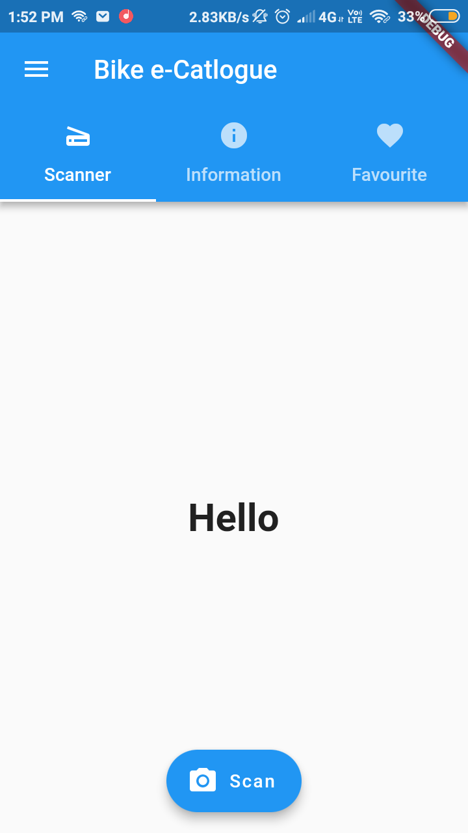
Home Page

Slide 8
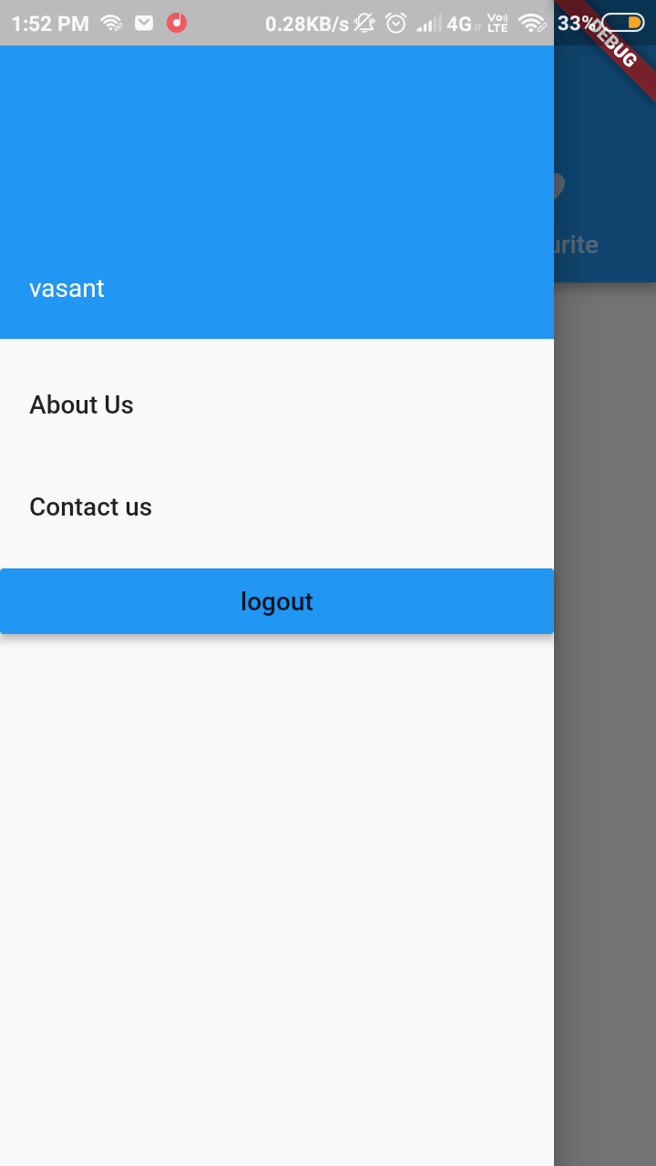

Slide 9
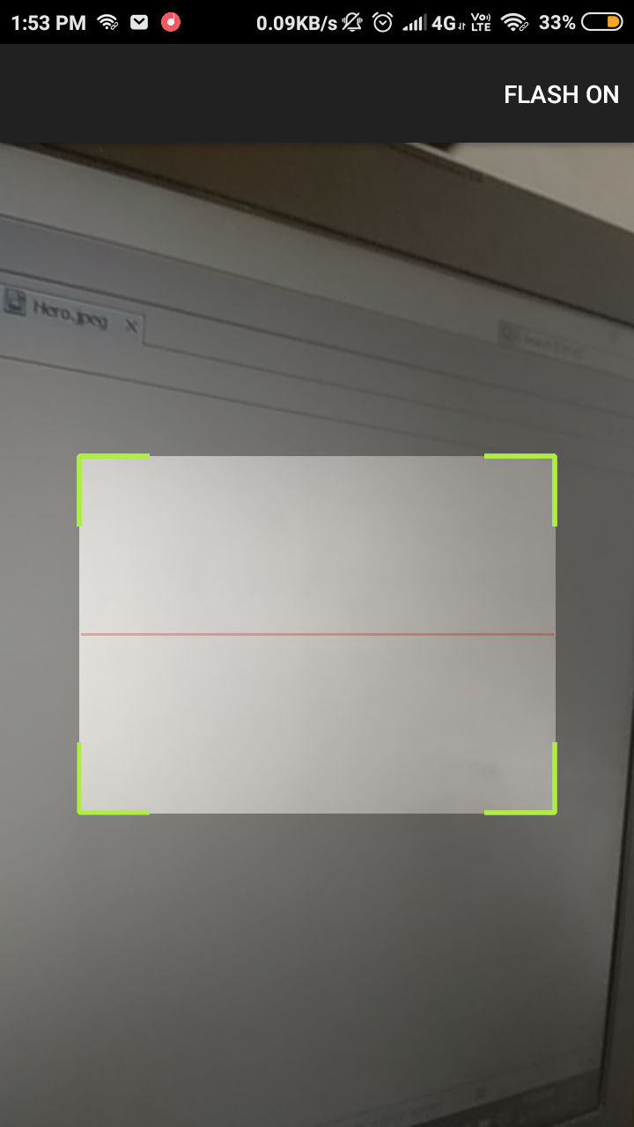
Scanner

Slide 10
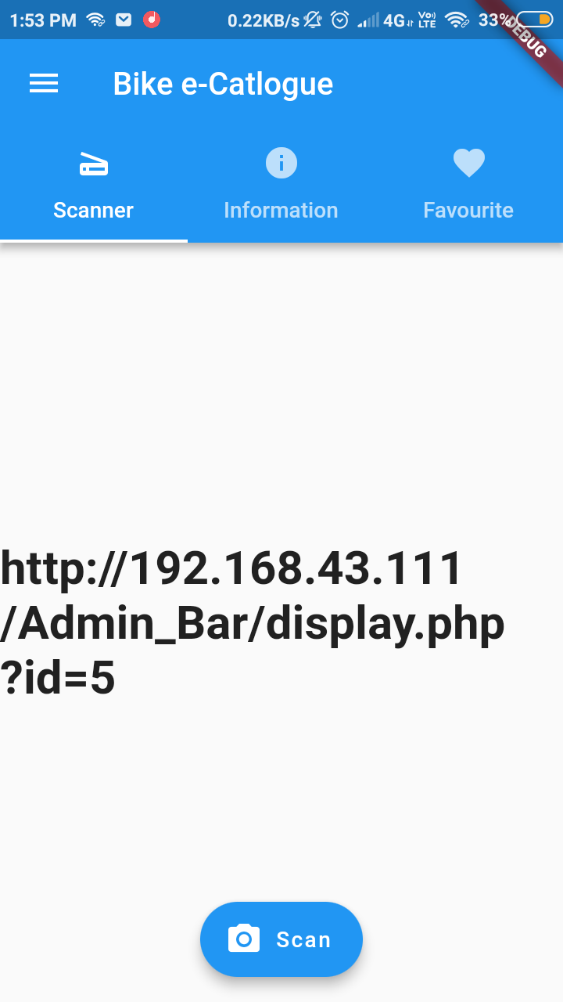

Slide 11
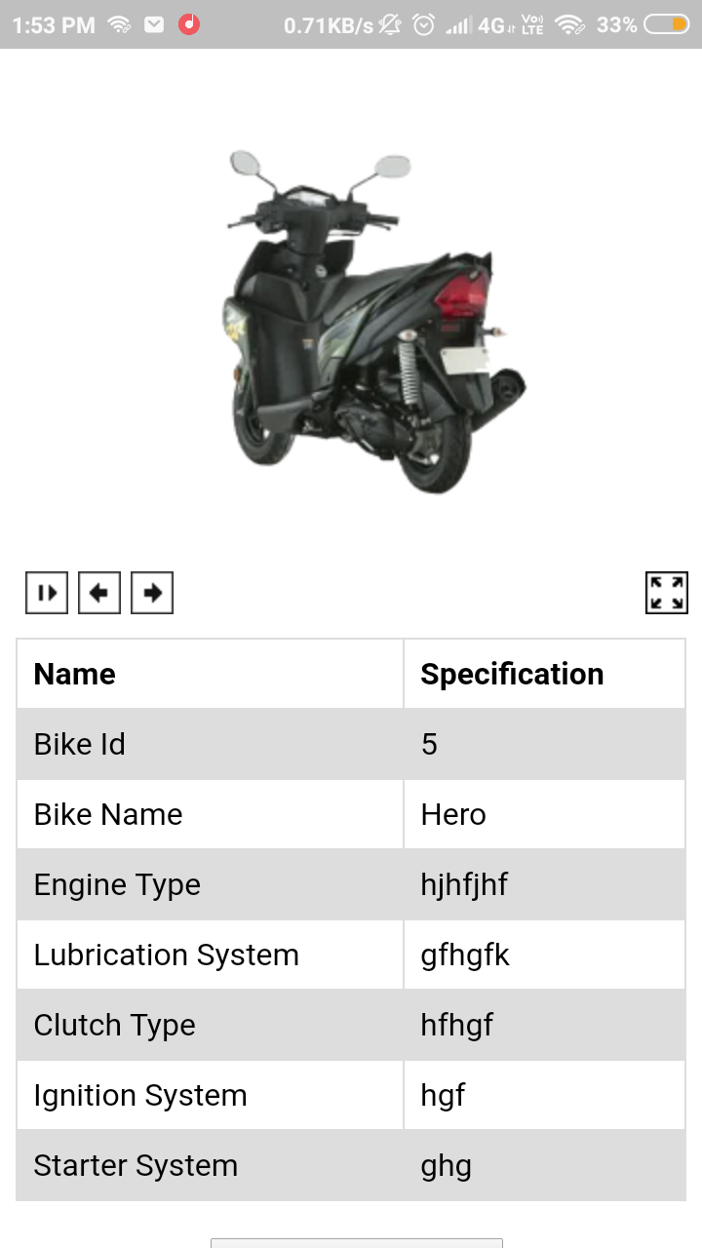
Info Display

